Slide 1
Some parameters to customize basic plots

Slide 2
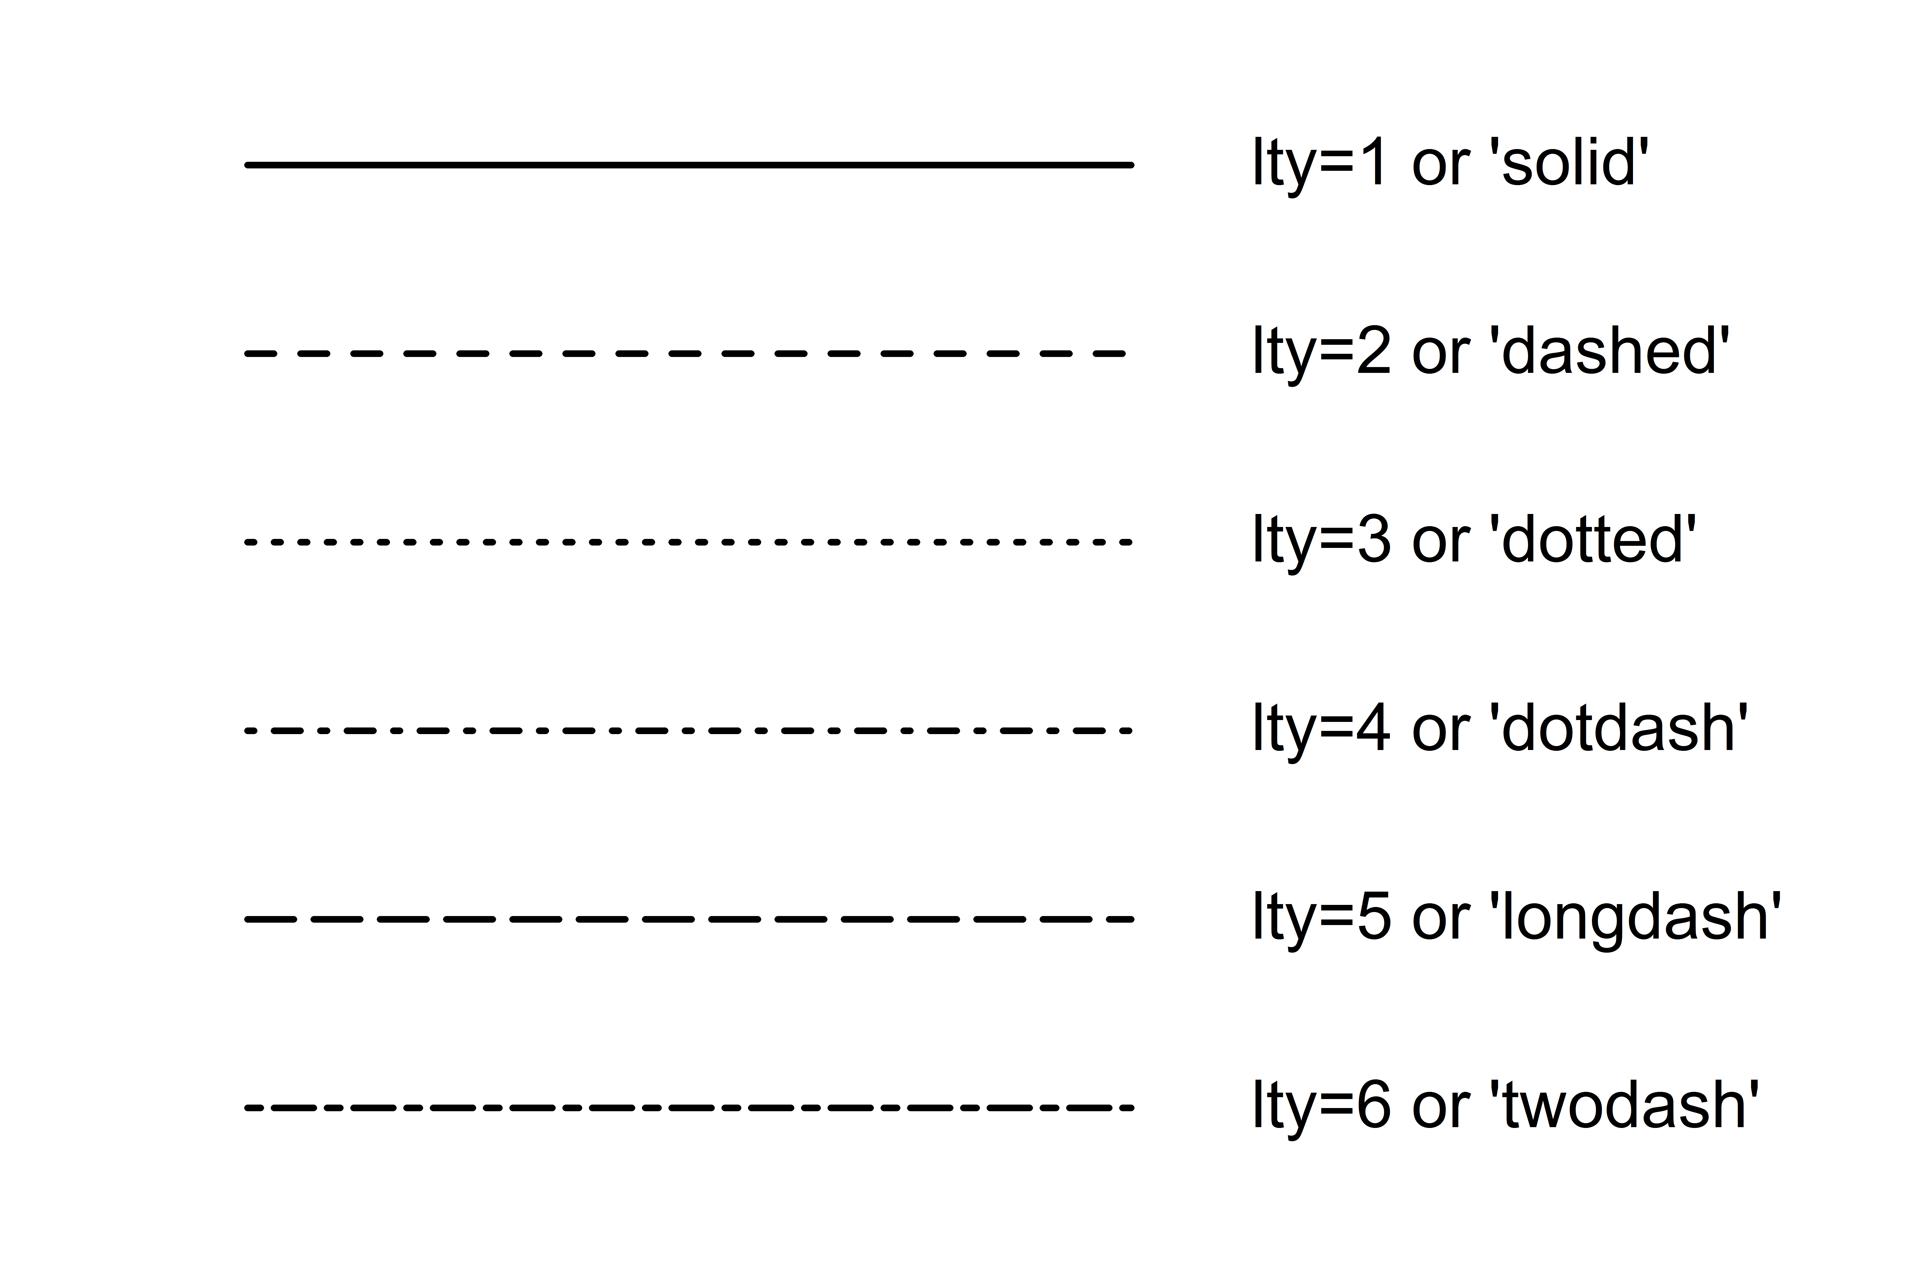
Lines
lty | line type(default=1).
lty=0 corresponds to ‘blank’ line (no line)
lty > 6 corresponds to the remainder of lty/6,
e.g., lty=7 is “solid”(1), lty=9 is “dotted” etc.
lwd | line width relative to the default (default=1). 2 is twice as wide

Slide 3
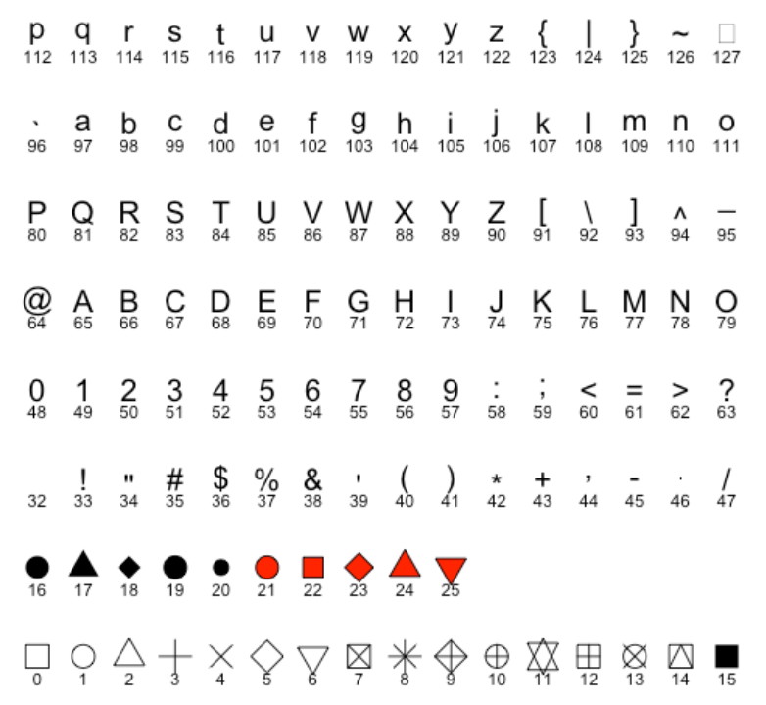
Points
pch : shape(see Figure)
col : color for the points
bg : the background (or fill) color for the open plot symbols.
It can be used only when pch = 21:25.
cex : the size of pch symbols
lwd : the line width for the plotting symbols
Figure 2. Point shapes

Slide 4
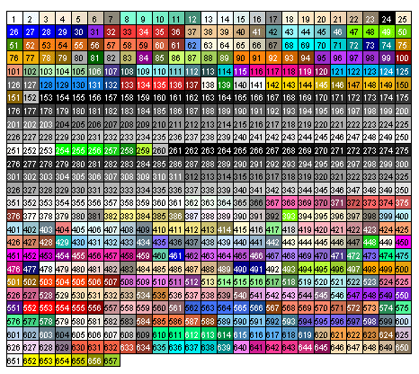
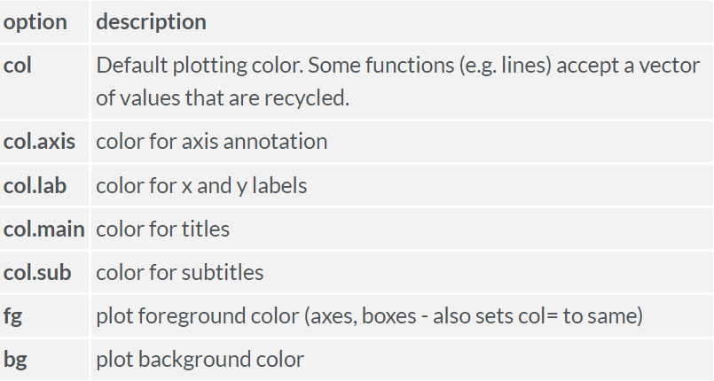
Colors
Default palette (indexes)
You can specify colors in R by index(from palette), name, hexadecimal, e.g.,
col=552,
col=“red",
col="#FF0000“.
Also, you can convert the same color from RGB code:
col=rgb(1,0,0),
col=rgb(255,0,0,maxColorValue = 255) are equivalent.

Slide 5
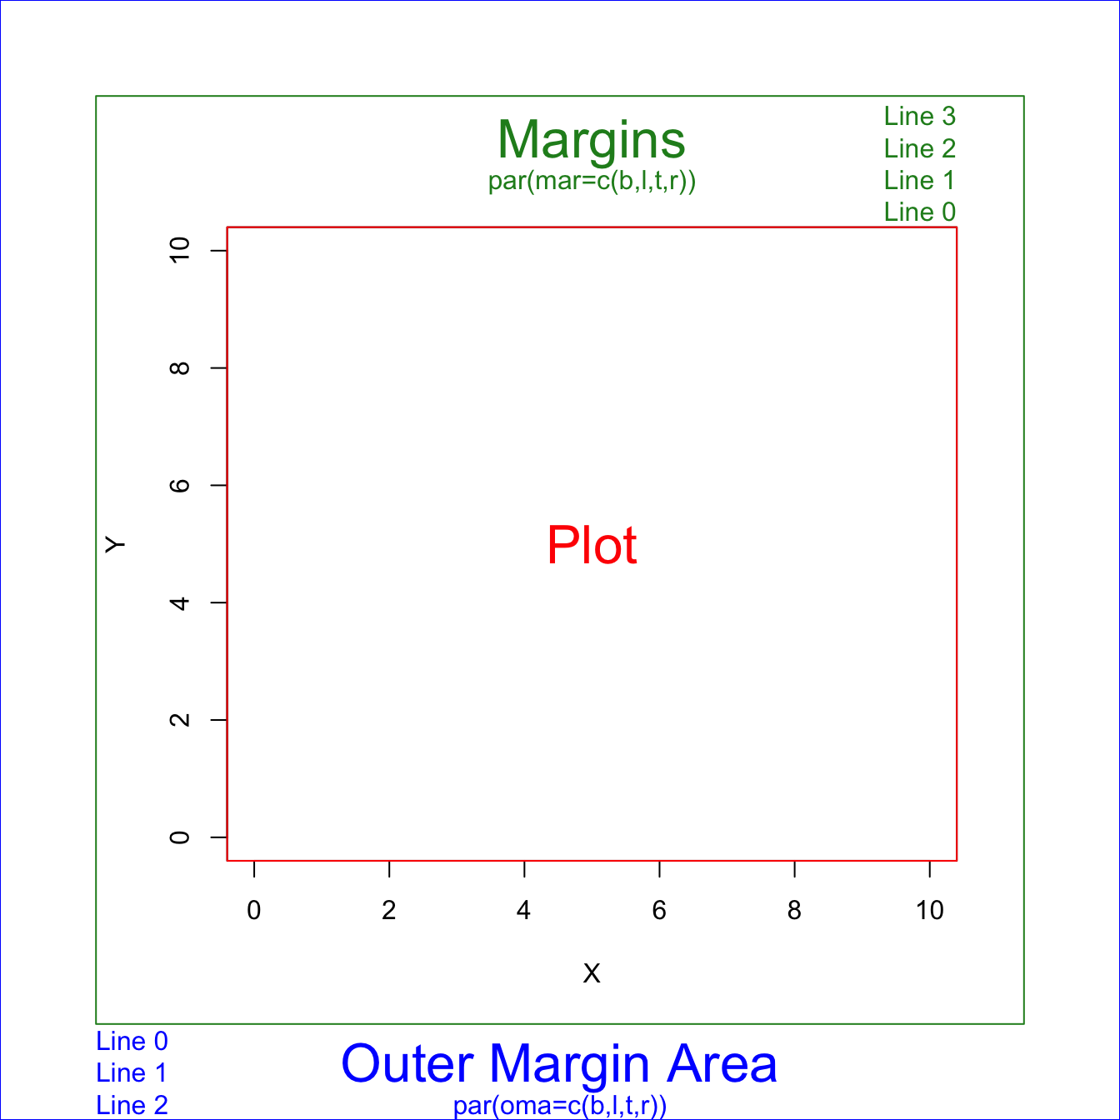
Margins
There are 2 margin areas in base R plots: margin and oma. You can control their size calling the par() function before your plot and setting the corresponding arguments mar() and oma(). Each of them is a numerical vector indicating size c(bottom, left, top, right) in lines.
By default,
par(mar = c(5, 4, 4, 2) + 0.1)
par(oma = c(0, 0, 0, 0))
You can use mai() and omi() if you want to set the areas in inches.

